Slide 1
Computer Science 101
Introduction to Programming

Slide 2
What Is a Program?
Usually, one or more algorithms written in a programming language that can be translated to run on a real machine
We sometimes call programs software

Slide 3
What Is a Programming Language?
A programming language is somewhat like a natural language, but with a very limited set of statements and strict syntax rules.
Has statements to implement sequential, conditional and iterative processing - algorithms
Examples: FORTRAN, COBOL, Lisp, Basic, Pascal, C, C⁺⁺, Java, C#, Python, …

Slide 4
Compiler
A compiler is a program that converts a program written in a programming language into a program in the native language, called machine language, of the machine that is to execute the program.

Slide 5
From Algorithms to Hardware
(with compiler)
Algorithm
Translate (by a human being)
Program
Translate (by compiler program)
A real computer

Slide 6
The Program Development Process (Data Flow)
Algorithm
Editor
Program in programming language
Compiler
Program in machine’s language
A real computer
Input
Output

Slide 7
The Program Development Process (Control Flow)
Edit
Syntax errors
Compile
Run
Input
Output
Runtime errors

Slide 8
Three kinds of errors
Syntax error : Some statement in the program is not a legal statement in the language.
Runtime error : An error occurs while the program is executing, causing the program to terminate (divide by zero, etc.)
Logic error : The program executes to completion, but gives incorrect results.

Slide 9
Interpreter
An alternative to a compiler is a program called an interpreter. Rather than convert our program to the language of the computer, the interpreter takes our program one statement at a time and executes a corresponding set of machine instructions.

Slide 10
Interpreter
Edit
Syntax or runtime errors
Input
Interpreter
Output

Slide 11
Python
Python is a real-world, production language that is freely available for most computers.
http:www.python.org_x000b_
If you want a copy of Python to use with this course, go to
http://code.google.com/p/mediacomp-jes/ .
We are using JES (Jython Environment for Students) which has a lot of special multimedia functionality.
Note: Our textbook covers a limited amount of Python. There are many excellent online tutorials. For example, see
http://en.wikibooks.org/wiki/Non-Programmer's_Tutorial_for_Python/Contents_x000b_

Slide 12
Python
Python uses an interpreter. Not only can we write complete programs, we can work with the interpreter in a statement by statement mode enabling us to experiment quite easily.
Python is especially good for our purposes in that it does not have a lot of “overhead” before getting started.
It is easy to jump in and experiment with Python in an interactive fashion.

Slide 13
Language terminology
Syntax: The formal rules for legal statements in the language.
Semantics: The meaning of the statements - what happens when the statement is executed.

Slide 14
Three major control constructs of programming
(Execution flow of instructions)
Sequential: Simply do steps one after the other in order they are listed.
Conditional: Decide which statement to do next based on some true/false test.
Iterative: A set of statements is repeated over and over until some condition is met.

Slide 15
Sequential Operations
“Atomic”
Step i
Input
Computation
Output
Step i+1
Step i+2

Slide 16
The Big Plan
We want to get some experience of programming simple algorithms in a real programming language. This gives us an understanding of how software is written and allows us to test our algorithms to see if they work.
We’ll first work with programs where the variables have numbers as values.
Later we’ll work with programs dealing with pictures and sound.
In lab we’ll work with some simple statements and small programs.

Slide 17
The Basic Pattern
Most of our programs will use the basic pattern of
  Get some user input
  Perform some algorithm on the input
  Provide results as output

Slide 18
Identifiers
Identifiers are names of various program elements in the code that uniquely identify the elements. They are the names of things like variables or functions to be performed. They're specified by the programmer and should have names that indicate their purpose.
In Python, identifiers
  Are made of letters, digits and underscores
  Must begin with a letter or an underscore
  Examples: temperature, myPayrate, score2

Slide 19
Keywords
Keywords are reserved words that have special meaning in the Python language. Because they are reserved, they can not be used as identifiers. Examples of keywords are if, while, class, import.

Slide 20
Variables in Python
A variable has
  A name – identifier
  A data type - int, float, str, etc.
  Storage space sufficient for the type.

Slide 21
Numeric Data Types
int
This type is for whole numbers, positive or negative. Examples: 23, -1756
float
This type is for numbers with possible fraction parts. Examples: 23.0, -14.561

Slide 22
Integer operators
The operations for integers are:
  + for addition
  - for subtraction
  * for multiplication
  / for integer division: The result of 14/5 is 2
  % for remainder: The result of 14 % 5 is 4
*, /, % take precedence over +, -
  x + y * z will do y*z first
Use parentheses to dictate order you want.
  (x+y) * z will do x+y first.

Slide 23
Integer Expressions
Integer expressions are formed using
  Integer Constants
  Integer Variables
  Integer Operators
  Parentheses

Slide 24
Python Assignment Statements
In Python, = is called the assignment operator and an assignment statement has the form
<variable> = <expression>
Here
  <variable> would be replaced by an actual variable
  <expression> would be replaced by an expression
Python: age = 19

Slide 25
Python Assignment Statement
Syntax: <variable> = <expression>
  Note that variable is on left
Semantics:
  Compute value of expression
  Store this as new value of the variable
Example: Pay = PayRate * Hours
10
40
400
Payrate
Hours
Pay

Slide 26
Assignment Example
Before
X
3
Y
5
Z
12
Execute
Z = X * 3 + Z / Y
After
X
3
Y
5
Z
11

Slide 27
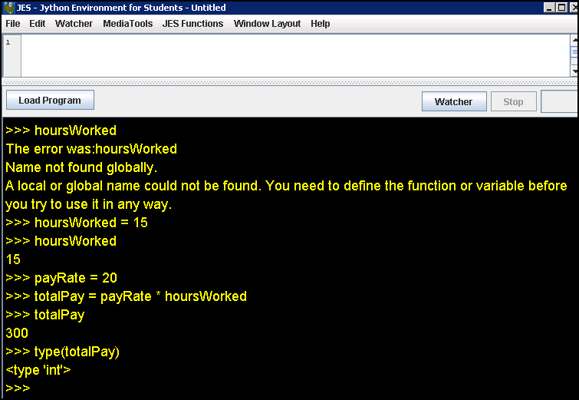
Python Session

Slide 28
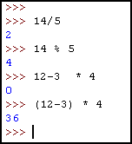
Python Session

Slide 29
What about floats?
When computing with floats, / will indicate regular division with fractional results.
Constants will have a decimal point.
14.0/5.0 will give 2.8 while 14/5 gives 2.

Slide 30
Comments
Often we want to put some documentation in our program. These are comments for explanation, but not executed by the computer.
If we have # anywhere on a line, everything following this on the line is a comment – ignored

Slide 31
Numerical Input
To get numerical input from the user, we use an assignment statement of the form
<variable> = input(<prompt>)
Here
  <prompt> would be replaced by a prompt for the user inside quotation marks
  If there is no prompt, the parentheses are still needed
Semantics
  The prompt will be displayed
  User enters number
  Value entered is stored as the value of the variable

Slide 32
Print Statement
For output we use statements of the form
print <expression>
Semantics
  Value of expression is computed
  This value is displayed
Several expressions can be printed – separate them by commas

Slide 33
Example - Fahrenheit to Centigrade
We want to convert a Fahrenheit temperature to Centigrade.
The formula is C = (F -32) x 5/9
We use type float for the temperatures.

Slide 34
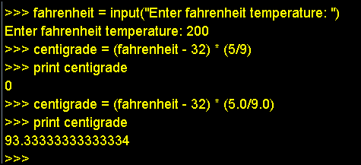
Python Session

Slide 35
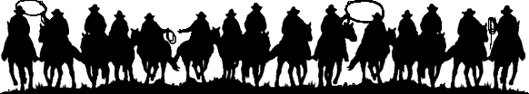
If we figure this out once,
let’s remember what we did!

